Slide 1

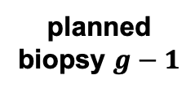
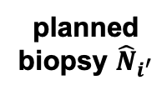
delay in
detection
last
biopsy
planned
biopsy 1
planned
biopsy $g−1$
true
progression
planned
biopsy $g$
planned
biopsy ${\hat{N}}_{i^{′}}$
number
of biopsies
to be conducted

